Slide 1
Analytical Functions (Rank;Dense_Rank;Row_Number)

Slide 2
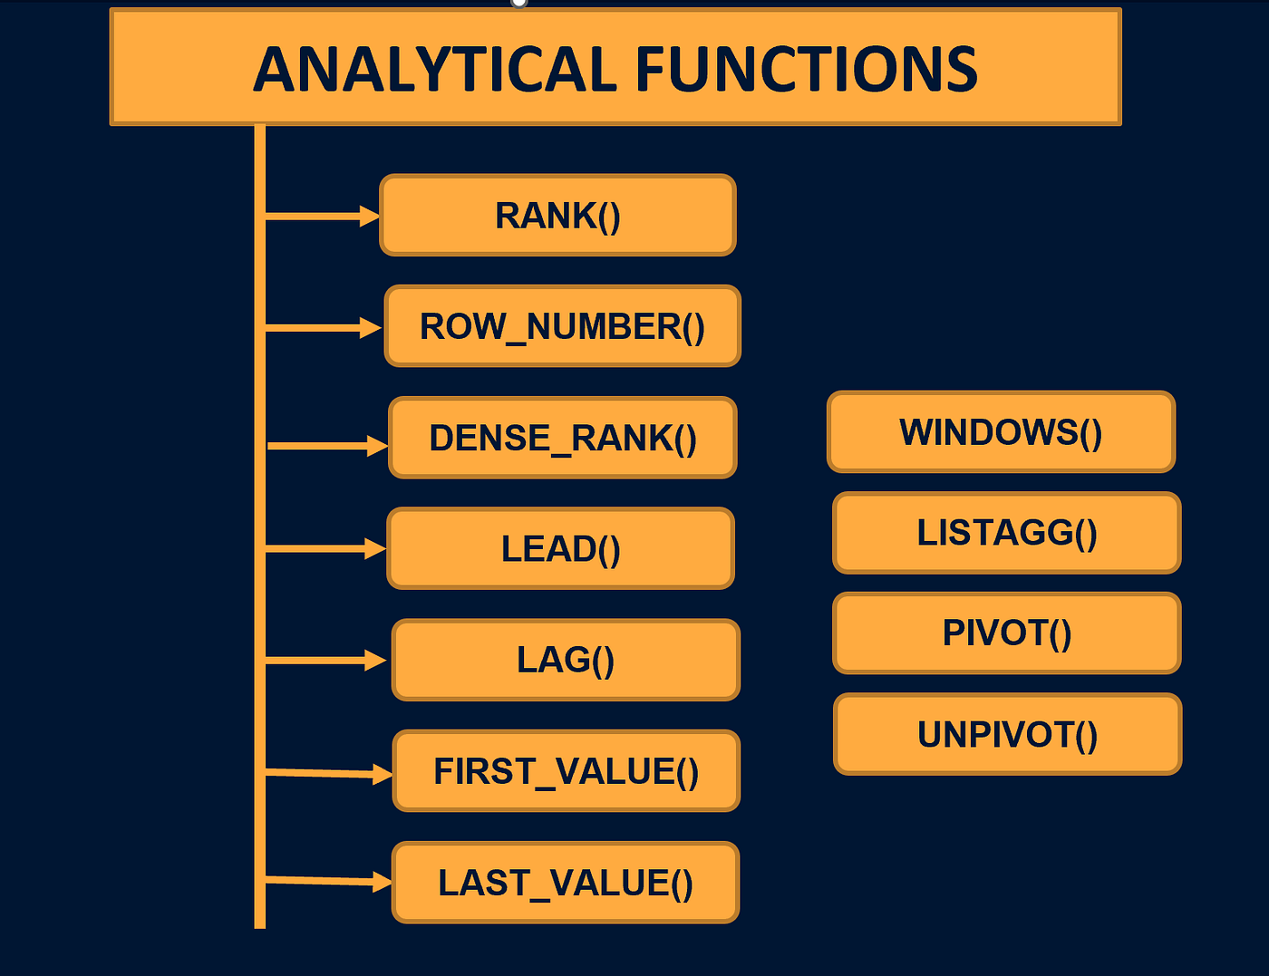
Analytical Functions
Analytical functions perform calculations across a set of rows related to the current row.
Unlike aggregate functions, they do not collapse rows into a single output.
Commonly used with the OVER() clause.
Allow partitioning and ordering of data for detailed analysis.

Slide 3
Rank
The RANK function is an analytical function in SQL. Assigns a rank to each row based on a specific order of a column. Rows with the same value get the same rank, but gaps appear in ranking after ties.
Syntax: RANK() OVER (PARTITION BY column_name ORDER BY column_name [ASC|DESC])
Explanation:
OVER(): Defines the order for ranking.
PARTITION BY: Optional; divides data into groups before ranking.
ORDER BY: Defines the column(s) to rank.

Slide 4
Rank
Example Table:Employees
EmpID | Name | Department | Salary
1 | John | IT | 50000
2 | Alice | HR | 60000
3 | Bob | IT | 70000
4 | Lisa | HR | 60000
5 | David | IT | 70000
6 | Emma | HR | 55000
7 | Michael | IT | 50000
8 | Sophia | HR | 60000
9 | Daniel | IT | 65000
10 | Olivia | HR | 55000

Slide 5
Rank
RANK WITHOUT PARTITION
SELECT Name, Department, Salary,
RANK() OVER (ORDER BY Salary DESC) AS Rank
FROM Employees;
Name | Department | Salary | Rank
Bob | IT | 70000 | 1
David | IT | 70000 | 1
Daniel | IT | 65000 | 3
Alice | HR | 60000 | 4
Lisa | HR | 60000 | 4
Sophia | HR | 60000 | 4
Emma | HR | 55000 | 7
Olivia | HR | 55000 | 7
John | IT | 50000 | 9
Michael | IT | 50000 | 9

Slide 6
Rank
RANK WITH PARTITION BY
SELECT Name, Department, Salary,
RANK() OVER (PARTITION BY Department ORDER BY Salary DESC) AS DeptRank
FROM Employees;
Name | Department | Salary | DeptRank
Bob | IT | 70000 | 1
David | IT | 70000 | 1
Daniel | IT | 65000 | 3
John | IT | 50000 | 4
Michael | IT | 50000 | 4
Alice | HR | 60000 | 1
Lisa | HR | 60000 | 1
Sophia | HR | 60000 | 1
Emma | HR | 55000 | 4
Olivia | HR | 55000 | 4

Slide 7
Rank
Notes:
(In RANK WITHOUT PARTITION)
Bob and David have the same salary, so they share same rank, Rank 1.
The next rank after the tie is 3, not 2 (gap exists).
(In RANK WITH PARTITION)
Ranking is now per department, making it easier to analyze top performers in each group.
Real-World Usage of RANK
Employee Performance: Rank employees based on performance scores or sales.
Competitions: Assign ranks to participants based on scores or timings.
E-commerce: Rank products based on ratings or sales.
Analytics: Identify top N performers or products in each category

Slide 8
Dense_Rank
The Dense_RANK function is an analytical function in SQL. Assigns a rank to each row based on a specific order of a column. Rows with the same value get the same rank.
Syntax: DENSE_RANK() OVER (PARTITION BY column_name ORDER BY column_name [ASC|DESC])
Explanation:
OVER(): Defines the order for ranking.
PARTITION BY: Optional; divides data into groups before ranking.
ORDER BY: Defines the column(s) to rank.

Slide 9
Dense_Rank
Example Table:Employees
EmpID | Name | Department | Salary
1 | John | IT | 50000
2 | Alice | HR | 60000
3 | Bob | IT | 70000
4 | Lisa | HR | 60000
5 | David | IT | 70000
6 | Emma | HR | 55000
7 | Michael | IT | 50000
8 | Sophia | HR | 60000
9 | Daniel | IT | 65000
10 | Olivia | HR | 55000

Slide 10
Dense_Rank
DENSE_RANK WITHOUT PARTITION
SELECT Name, Department, Salary,
DENSE_RANK() OVER (ORDER BY Salary DESC) AS Dense_Rank
FROM Employees;
Name | Department | Salary | Dense_Rank
Bob | IT | 70000 | 1
David | IT | 70000 | 1
Daniel | IT | 65000 | 2
Alice | HR | 60000 | 3
Lisa | HR | 60000 | 3
Sophia | HR | 60000 | 3
Emma | HR | 55000 | 4
Olivia | HR | 55000 | 4
John | IT | 50000 | 5
Michael | IT | 50000 | 5

Slide 11
Rank
DENSE_RANK WITH PARTITION BY
SELECT Name, Department, Salary,
DENSE_RANK() OVER (PARTITION BY Department ORDER BY Salary DESC) AS DeptRank
FROM Employees;
Name | Department | Salary | DeptRank
Bob | IT | 70000 | 1
David | IT | 70000 | 1
Daniel | IT | 65000 | 2
John | IT | 50000 | 3
Michael | IT | 50000 | 3
Alice | HR | 60000 | 1
Lisa | HR | 60000 | 1
Sophia | HR | 60000 | 1
Emma | HR | 55000 | 2
Olivia | HR | 55000 | 2

Slide 12
Dense_Rank
Notes:
(In DENSE_RANK WITHOUT PARTITION)
Bob and David have the same salary, so they share same rank, Rank 1.
The next dense_rank after the tie is 2, not 3 (gap doesn’t exists).
(In RANK WITH PARTITION)
Ranking is now per department, making it easier to analyze top performers in each group.
Real-World Usage of DENSE_RANK
Employee Appraisal: Rank employees by performance or sales, ensuring no gaps in ranks.
University Admissions: Assign ranks to students based on marks; ties share the same rank, next continues consecutively.
Sports Competitions: Rank athletes based on score or timing; fair ranking without skipping numbers.
Sales Analysis: Rank products by revenue or quantity sold; useful in dashboards and reports.
Customer Loyalty: Rank customers based on total purchases or points for reward tiers.
E-commerce: Rank items by ratings, reviews, or sales — ensures continuous rank list for filtering.
Analytics & BI: Identify top N performers/products in each category without gaps in ranking.

Slide 13
Difference Between Rank and Dense_Rank
Feature | RANK() | DENSE_RANK()
Definition | Assigns rank to rows with gaps if there are ties. | Assigns rank to rows without gaps, even if there are ties.
Handling of Ties | Same rank is given to tied rows, but the next rank is skipped. | Same rank is given to tied rows, but the next rank continues sequentially.
Example (Scores: 95, 90, 90, 85) | Ranks = 1, 2, 2, 4 (gap after 2) | Ranks = 1, 2, 2, 3 (no gap after 2)
Use Case | When actual ranking order (with skipped positions) is important. | When continuous ranking is required for reporting.
Output Style | Produces gaps in ranking numbers. | Produces consecutive ranking numbers.
Performance | Similar to DENSE_RANK() (both are window functions). | Similar to RANK() (both are window functions).

Slide 14
Row_Number
ROW_NUMBER() is a window function in SQL.It assigns a unique sequential number to each row within a result set.
Even if rows have the same values, ROW_NUMBER does not skip or repeat numbers
Syntax: ROW_NUMBER() OVER ( [PARTITION BY column_name] ORDER BY column_name [ASC|DESC] )
Explanation:
OVER(): Defines the order for row_numbering.
PARTITION BY:Optional,divides data into groups.
ORDER BY: Defines ordering inside each partition.

Slide 15
Row_Number
Example Table:Employees
EmpID | Name | Department | Salary
1 | John | IT | 50000
2 | Alice | HR | 60000
3 | Bob | IT | 70000
4 | Lisa | HR | 60000
5 | David | IT | 70000
6 | Emma | HR | 55000
7 | Michael | IT | 50000
8 | Sophia | HR | 60000
9 | Daniel | IT | 65000
10 | Olivia | HR | 55000

Slide 16
Rank
ROW_NUMBER WITHOUT PARTITION
SELECT Name, Department, Salary,
ROW_NUMBER() OVER (ORDER BY Salary DESC) AS Row_Number
FROM Employees;
Name | Department | Salary | Row_Number
Bob | IT | 70000 | 1
David | IT | 70000 | 2
Daniel | IT | 65000 | 3
Alice | HR | 60000 | 4
Lisa | HR | 60000 | 5
Sophia | HR | 60000 | 6
Emma | HR | 55000 | 7
Olivia | HR | 55000 | 8
John | IT | 50000 | 9
Michael | IT | 50000 | 10

Slide 17
Rank
ROW_NUMBER WITH PARTITION BY
SELECT Name, Department, Salary,
ROW_NUMBER() OVER (PARTITION BY Department ORDER BY Salary DESC) AS DeptRank
FROM Employees;
Name | Department | Salary | DeptRank
Bob | IT | 70000 | 1
David | IT | 70000 | 2
Daniel | IT | 65000 | 3
John | IT | 50000 | 4
Michael | IT | 50000 | 5
Alice | HR | 60000 | 1
Lisa | HR | 60000 | 2
Sophia | HR | 60000 | 3
Emma | HR | 55000 | 4
Olivia | HR | 55000 | 5

Slide 18
Row_Number
Real-World Usage of ROW_NUMBER
Pagination in Applications: Break large results into pages (e.g., display 10 records per page in e-commerce sites).
Removing Duplicates: Keep only the first occurrence in each partition while deleting duplicates.
Top-N Selection: Pick top N salaries, top N products by sales, or top N students by marks.
Sequential Numbering: Generate serial numbers for reports, invoices, or student roll lists.
Event Tracking: Order transactions, clicks, or activities for each user in sequence.
Data Sampling: Select every Nth row or random subsets for testing and analytics.
Audit & Logging: Assign unique row numbers to log entries for easy referencing

Slide 19
Analytical Functions
(Lead;Lag)

Slide 20
Lead
LEAD() is an analytic function that allows you to access the value from the next row in the same result set, without using a self-join.
It’s useful for comparing the current row with future rows.
Syntax: LEAD(column_name, offset, default_value) OVER (PARTITION BY col ORDER BY col)
Explanation:
column_name → Column to fetch value from next row.
offset → Number of rows forward to look (default is 1).
default_value → Value if next row does not exist.

Slide 21
Lead
Example Table:Sales
EmpID | Month | Sales
1 | Jan | 5000
1 | Feb | 6000
1 | Mar | 5500
2 | Jan | 4000
2 | Feb | 4500
2 | Mar | 4800

Slide 22
Lead
SELECT
EmpID,
Month,
Sales,
LEAD(Sales, 1, 0) OVER(PARTITION BY EmpID ORDER BY Month) AS NextMonthSales
FROM Sales;
EmpID | Month | Sales | NextMonthSales
1 | Jan | 5000 | 6000
1 | Feb | 6000 | 5500
1 | Mar | 5500 | 0
2 | Jan | 4000 | 4500
2 | Feb | 4500 | 4800
2 | Mar | 4800 | 0

Slide 23
Lead
Real-World Usage of Lead
Compare a person’s sales with next month’s sales.
Stock market: compare today’s price with tomorrow’s price.
Customer churn: see whether the next transaction exists

Slide 24
Lag
LAG() is an analytic function that allows you to access the value from the previous row in the same result set, without using a self-join.
It’s useful for comparing the current row with past rows.
Syntax: LAG(column_name, offset, default_value) OVER (PARTITION BY col ORDER BY col)
Explanation:
column_name → Column to fetch value from previous row.
offset → Number of rows backward to look (default is 1).
default_value → Value if previous row does not exist.

Slide 25
Lag
Example Table:Sales
EmpID | Month | Sales
1 | Jan | 5000
1 | Feb | 6000
1 | Mar | 5500
2 | Jan | 4000
2 | Feb | 4500
2 | Mar | 4800

Slide 26
Lag
SELECT
EmpID,
Month,
Sales,
LAG(Sales, 1, 0) OVER(PARTITION BY EmpID ORDER BY Month) AS PreviousMonthSales
FROM Sales;
EmpID | Month | Sales | PreviousMonthSales
1 | Jan | 5000 | 0
1 | Feb | 6000 | 5000
1 | Mar | 5500 | 6000
2 | Jan | 4000 | 5500
2 | Feb | 4500 | 4000
2 | Mar | 4800 | 4500

Slide 27
Lead
Real-World Usage of Lead
Compare current sales vs. previous month’s sales.
Stock market: see today’s price compared to yesterday’s price.
Track performance: compare student’s current score vs. previous exam

Slide 28
Difference between Lead and Lag
Feature | LEAD Function | LAG Function
Definition | Returns the value of a column from the next row in the result set. | Returns the value of a column from the previous row in the result set.
Direction | Looks forward (down) in the dataset. | Looks backward (up) in the dataset.
Usage | Used to compare current row with future rows. | Used to compare current row with past rows.
Syntax | LEAD(column, offset, default) OVER (ORDER BY col) | LAG(column, offset, default) OVER (ORDER BY col)
Offset | Offset defines how many rows ahead to look. | Offset defines how many rows back to look.
Default Value | Can specify a default value if no next row exists. | Can specify a default value if no previous row exists.
Example Scenario | Finding next month’s sales for comparison. | Finding previous month’s sales for comparison.

Slide 29
Partition By and Order By

Slide 30
Partition By
Used to divide the result set into smaller groups (partitions).
The analytic function is then calculated separately for each partition.
Unlike GROUP BY ,rows are not collapsed → each row still appears in output.
If no PARTITION BY is given, whole result set is treated as one partition.
Example Table: Employee_Sales
EmpID | EmpName | Dept | Sales
1 | Asha | HR | 3000
2 | Ravi | HR | 2500
3 | Neha | HR | 4000
4 | Kiran | IT | 5000
5 | Meena | IT | 4500
6 | Arjun | IT | 4700
7 | Sita | Sales | 6000
8 | Rohan | Sales | 5500
9 | Pooja | Sales | 5800
10 | Mohan | Sales | 5200

Slide 31
Partition By
SELECT EmpName, Dept, Sales,
SUM(Sales) OVER (PARTITION BY Dept) AS Dept_Total
FROM Employee_Sales;
EmpName | Dept | Sales | Dept_Total
Asha | HR | 3000 | 9500
Ravi | HR | 2500 | 9500
Neha | HR | 4000 | 9500
Kiran | IT | 5000 | 14200
Meena | IT | 4500 | 14200
Arjun | IT | 4700 | 14200
Sita | Sales | 6000 | 22500
Rohan | Sales | 5500 | 22500
Pooja | Sales | 5800 | 22500
Mohan | Sales | 5200 | 22500

Slide 32
Order By
ORDER BY defines the sequence of rows within each partition.
Often used with functions like Row_Number,Rank,Lead,Lag.
Without Order By,Window Functions won’t calculate row-wise progression.
Example Table: Employee_Sales
EmpID | EmpName | Dept | Sales
1 | Asha | HR | 3000
2 | Ravi | HR | 2500
3 | Neha | HR | 4000
4 | Kiran | IT | 5000
5 | Meena | IT | 4500
6 | Arjun | IT | 4700
7 | Sita | Sales | 6000
8 | Rohan | Sales | 5500
9 | Pooja | Sales | 5800
10 | Mohan | Sales | 5200

Slide 33
Order By
SELECT EmpName, Dept, Sales,
ROW_NUMBER() OVER (PARTITION BY Dept ORDER BY Sales DESC) AS Row_Num
FROM Employee_Sales;
EmpName | Dept | Sales | Row_Num
Neha | HR | 4000 | 1
Asha | HR | 3000 | 2
Ravi | HR | 2500 | 3
Kiran | IT | 5000 | 1
Arjun | IT | 4700 | 2
Meena | IT | 4500 | 3
Sita | Sales | 6000 | 1
Pooja | Sales | 5800 | 2
Rohan | Sales | 5500 | 3
Mohan | Sales | 5200 | 4

Slide 34
Usage of Partition By and Order By
Clause | Purpose | Example Query | Example Use Case
PARTITION BY | Divides result set into groups (like GROUP BY but keeps row-level data) | SUM(Salary) OVER(PARTITION BY Department) | Calculate total salary per department while still showing each employee’s row
ORDER BY | Orders rows within each partition before applying window function | ROW_NUMBER() OVER(ORDER BY Salary DESC) | Assign unique row numbers to employees based on descending salary
Both Together | Combines grouping + ordering for more detailed analysis | RANK() OVER(PARTITION BY Department ORDER BY Salary DESC) | Rank employees within each department by salary
Without Partition | Entire table is treated as one partition | DENSE_RANK() OVER(ORDER BY Marks DESC) | Rank students across whole university
With Partition | Ranking/aggregation restarts for each partition | DENSE_RANK() OVER(PARTITION BY Class ORDER BY Marks DESC) | Rank students within each class

